Slide 1
WebApi:
What is it? How can I use it?

Slide 2
What is Web Api?

Slide 3
Restful Framework for building HTTP based services

Slide 4
What does
Restful mean?

Slide 5
”Rest is an architectural style that abstracts the architectural elements within a distributed hypermedia system”
-- Wikipedia

Slide 6
Example
Restful Url
https://api.twitter.com/1.1/statuses/retweets/2

Slide 7
HTTP Based services done right

Slide 8
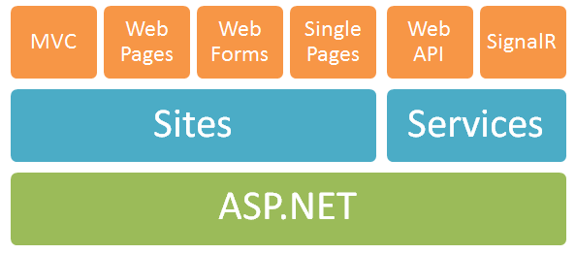
Are Web Api & Asp.Net Mvc the same?

Slide 9
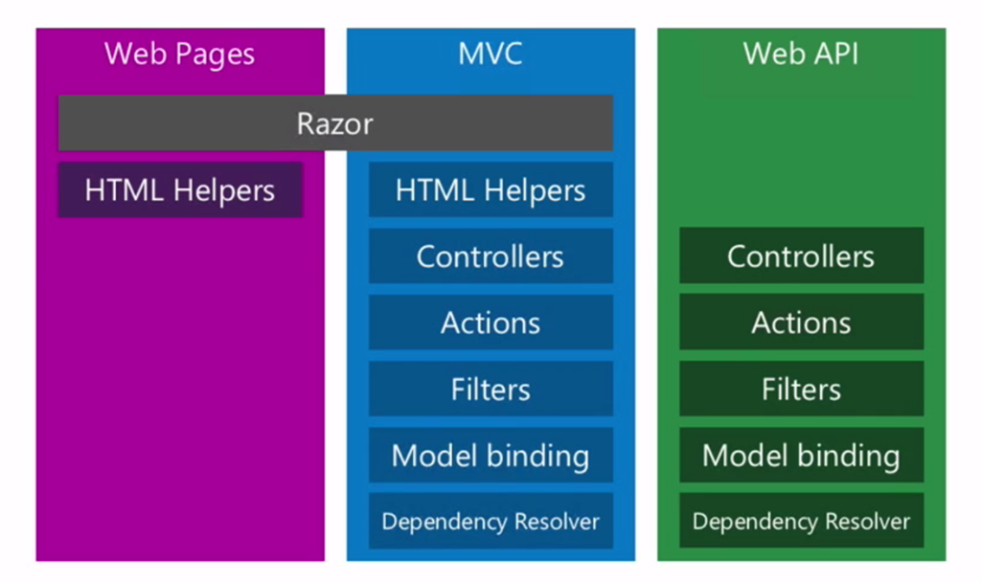
Web Api != Asp.Net MVC

Slide 10
Web Api can be classified as a sibling

Slide 11
Is Web Api a replacement for WCF?

Slide 12
Maybe…. It Depends

Slide 13
Use Web Api if..
Only working with HTTP
Want RESTful endpoints
Don’t need multiple protocols
Don’t expose SOAP endpoints
Want Simple Configuration

Slide 14
Use WCF if..
Needs to support multiple protocols
Need to expose SOAP endpoints
Need Complex Configuration
Need RPC Style Requests
Notes:
Mention that you can run WCF and WebApi side by side

Slide 15
Why use Web Api?

Slide 16
Minimal Friction
Notes:
Web API was built ontop of WCF but was also built to remove the configuration and friction that WCF introduced.
Web Api solves a different problem than WCF

Slide 17
Want multiple Hosting options

Slide 18
Want HTTP based endpoints
Notes:
Web API was built ontop of WCF but was also built to remove the configuration and friction that WCF introduced.
Web Api solves a different problem than WCF

Slide 19
Want Self Describing
HTTP Base API
Notes:
Web API was built ontop of WCF but was also built to remove the configuration and friction that WCF introduced.
Web Api solves a different problem than WCF

Slide 20
How to install Web Api?

Slide 21


Install via NuGet
Notes:
Web API was built ontop of WCF but was also built to remove the configuration and friction that WCF introduced.
Web Api solves a different problem than WCF

Slide 22
Web Api Features

Slide 23
Hosting Options
IIS Hosted
Self Hosted
Notes:
IIS Hosted
The Default
All the scalability of IIS by default
No special setup instructions
Self Hosted
Requires extras setup
Must implement http server
Highly customizable
Run as a service
Run as an application
Run embedded inside an app

Slide 24
Actions
Publicly Invokeable Methods
  Get, Post, Delete, Put, etc
Can return data
Can have filters

Slide 25
Routing
Finds Controller Actions
3 Components
  Controller/Action/Parameter
Multiple Ways to Configure
Notes:
Think of routing as map to get to our controller and action

Slide 26
Action Filters
Method of intercepting calls
  Almost like using an AOP framework
Can be applied to:
  Globally/Controller level/Each Action

Slide 27
Model Binding
Dynamic Type Transformation
Allows Validation
Allows Under/Over Posting

Slide 28
Content Negotiation
Media Type Negotiation
Encoding Type Negotiation
Custom Serializers

Slide 29
Demo

